Slide 1
HOW TO LEVERAGE
AI IN TEACHING
FDP-TCET

Slide 2
Today's Agenda
01
03
02
04
05
Mastering the prompt writing
AIPRM
Generating Prompts
eesel.ai
Research Rabbit

Slide 3
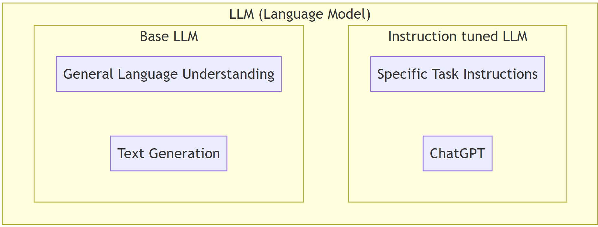
Recap:

Slide 4
01
Mastering Prompt Writing

Slide 5
REFERENCE :
http://bit.ly/chatgpt02

Slide 6
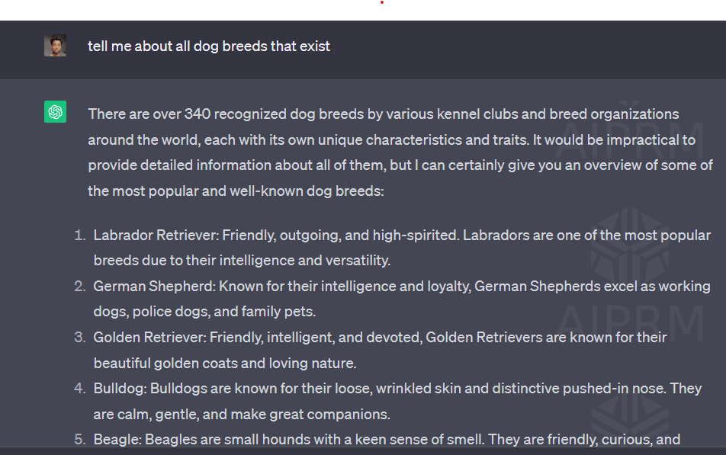
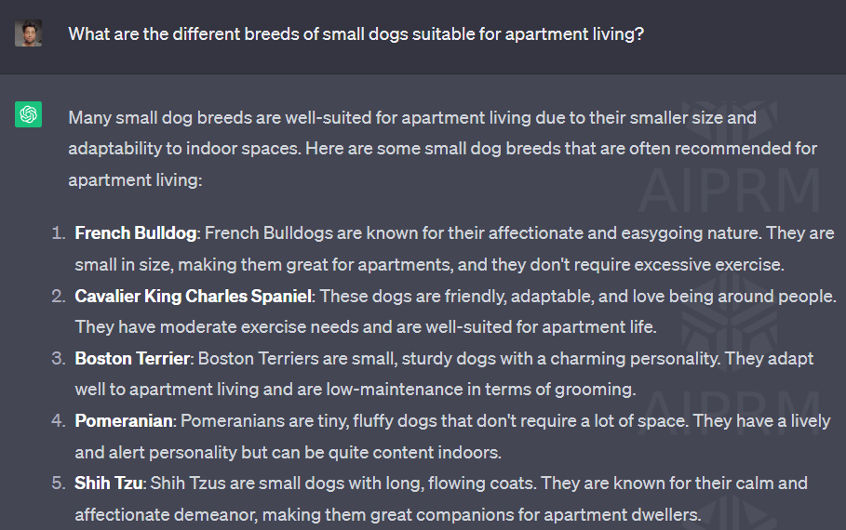
Be Specific

Slide 7
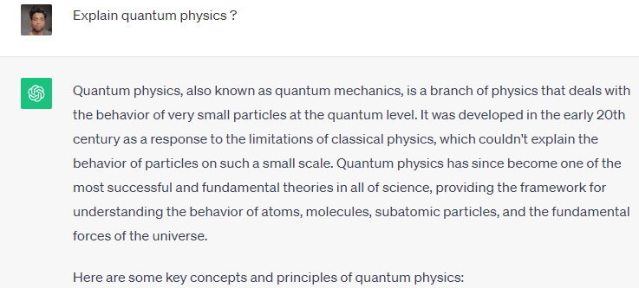
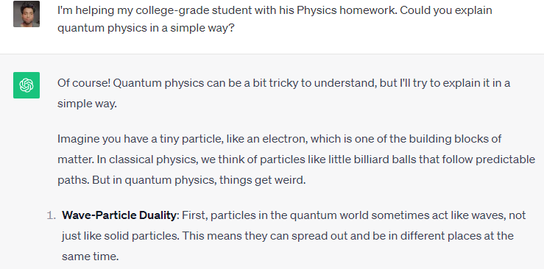
2.State Your Intent

Slide 8
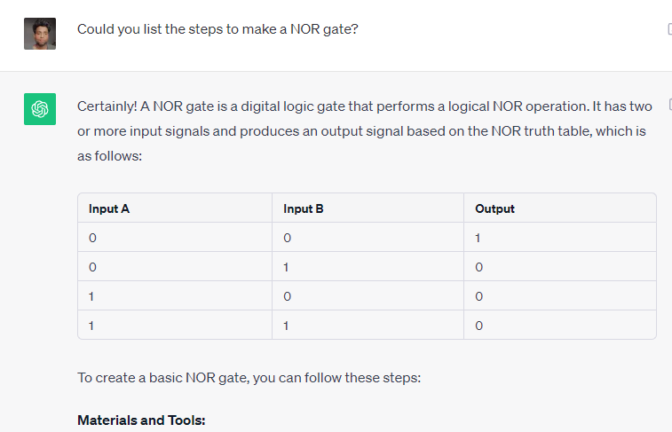
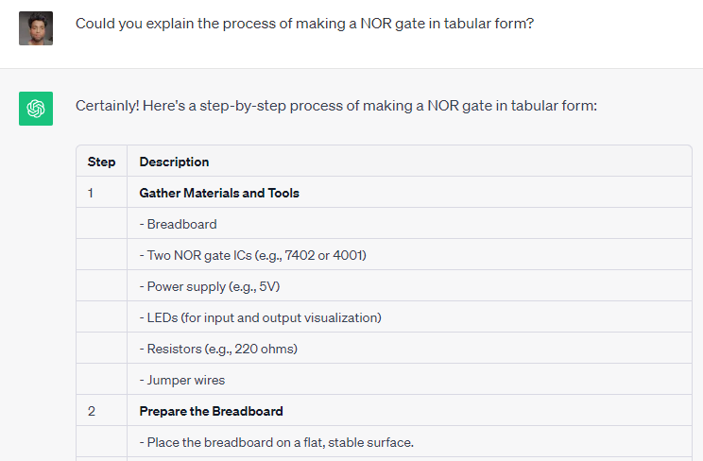
3. Direct the Output Format

Slide 9
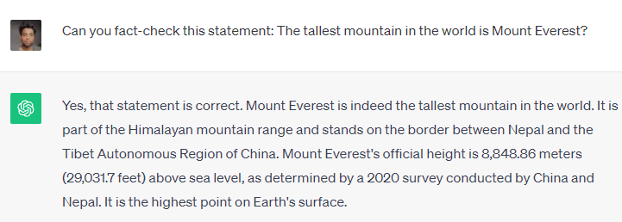
4. Prompt for Fact-Checking

Slide 10
5. Use Correct Spelling and Grammar
6. Ask Follow-Up Questions

Slide 11
PERFECT PROMPT :
[Context] + [Specific Information] + [Intent/Goal] + [Response Format (if needed)]

Slide 13
AIPRM- Artificial Intelligence-Powered Response Manager
Planning
Courses
Generate Prompt
Mermaid

Slide 14
Making are own Prompt

Slide 15
2. NoGPT
For checking if someone have directly copied from chatgpt or another AI tools.
https://nogpt.net/

Slide 16
3.eesel.ai
For getting answers from our own documents
https://www.eesel.ai/

Slide 17
4.Research Rabbit
For analyzing different research papers.
https://researchrabbitapp.com/

